Slide 1

Simbi Logistics Financial Performance Report Prepared By Adebiyi Victor Adejare Wetin Dey Code Academy June, 2026.

Slide 2
Outline
Introduction
Data Source and Overview
Objectives
Data Cleaning Process
Data Transformation, Analysis and Insights
Visualization
Conclusion
Recommendations
Appreciation
Contact Details

Slide 3
Introduction
Simbi Logistics is a delivery and dispatch service provider, serving businesses, e-commerce vendors, and individuals across Akure and Ondo State. The company specializes in last-mile logistics, including door-to-door deliveries, interstate parcel transit, and neighborhood errand services, with a reputation for fast and reliable delivery.
Purpose for Analysis;
To evaluate the company's financial performance and support data-driven decision making.
To examine profitability, expenses, and customer order patterns, providing insights that can help improve operational efficiency, increase profitability, and support sustainable business growth.

Slide 4
Data Source and Overview
The dataset used for this analysis was provided by the CEO of Simbi Logistics and it covers the period from 13th January 2025 to 31st March 2026. It consists of 442 rows and 12 columns. The dataset contains the following fields:
_______________
NO OF ORDERS
INCOME
FUEL
AIRTIME
SALARY
REPAIR&SERVI
CMINISGCELLANEOU
PSOLICE
TOTAL EXPENS
EBSALANCE
No of Riders

Slide 5
Objectives
Monitor profitability and provide clear visibility into daily, weekly, and monthly financial performance.
Analyze order trends and patterns to understand business demand, operational performance, and revenue generation across different time periods.

Slide 6
Data Cleaning Process
Tools used:
ChatGPT (for conversion)
Excel (for cleaning)
Cleaning Processes
PDF-to-Excel Conversion: The Simbi Logistics dataset was originally provided in a PDF file which I converted into an Excel file using ChatGPT. I launched the converted dataset in my Excel environment for data cleaning and preparation.

Slide 7
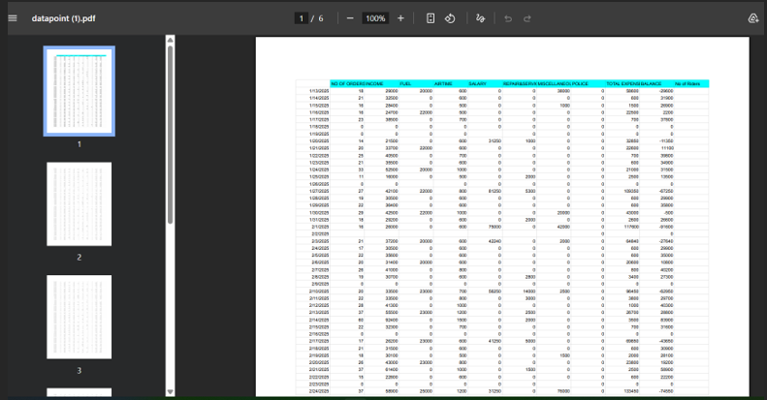
Data Cleaning Process CONT’D
i. PDF File

Slide 8
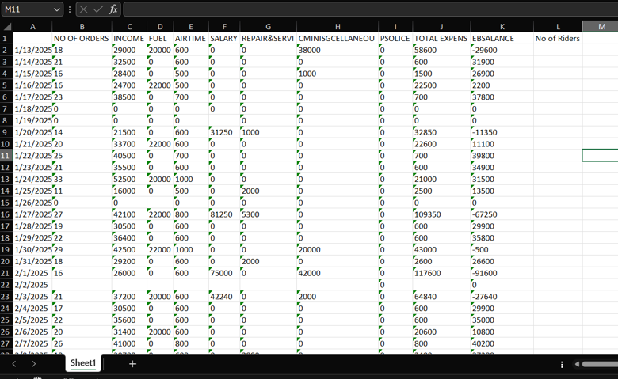
Data Cleaning Process CONT’D
ii. Excel File

Slide 9
Data Cleaning Process CONT’D
Column Formatting: I formatted ten (10) columns from Text to General using the Text to Columns feature under the Data tab and finally, I formatted each column back to Number respectively. This was necessary because, after the PDF-to-Excel conversion, an error came up that indicated that “the numbers in each column were formatted as text”. The following columns were incorrectly formatted as text:
NO OF ORDERS
INCOME
FUEL
AIRTIME
SALARY
REPAIR&SERVI
CMINISGCELLANEOU
PSOLICE
TOTAL EXPENS
EBSALANCE

Slide 10
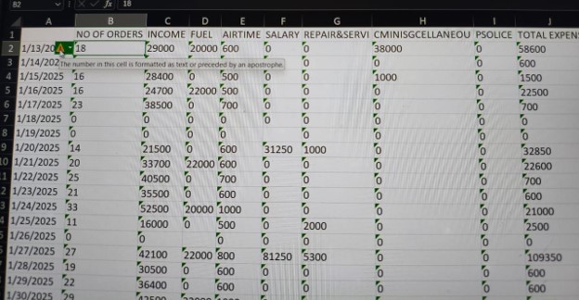
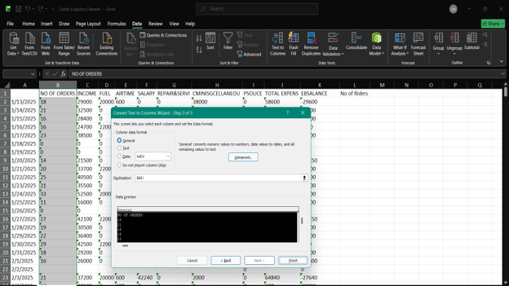
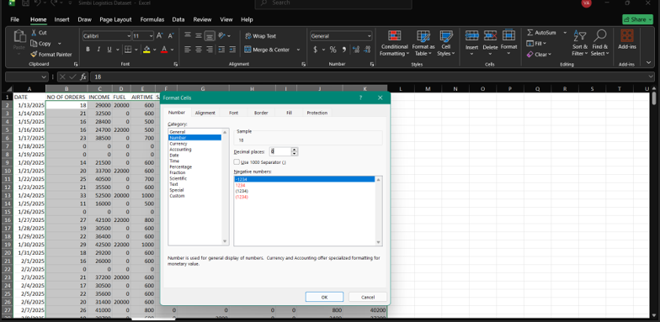
Data Cleaning Process CONT’D

Slide 11

Data Cleaning Process CONT’D
Editing and Proper Casing: I manually corrected errors and standardized the column headers by applying proper capitalization to ensure consistency and improve data readability. The corrected column headers include: “______” to “DATE”, “REPAIR&SERVI” to “REPAIR & SERVICES”, “CMINISGCELLANEOU” to “MISCELLANEOUS”, “PSOLICE” to “POLICE”, “TOTAL EXPENS” to “TOTAL EXPENSES”, “EBSALANCE” to “BALANCE”, and “No of Riders” to “NO OF RIDERS”.

Slide 12
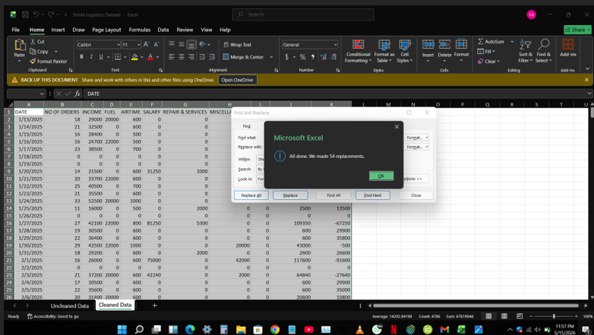
Data Cleaning Process CONT’D
Blank Space Detection and Replacement: I checked for blank cells using the New Formatting Rule option under Conditional Formatting in the Home tab. Several blank cells were identified, including missing values in the NO OF RIDERS column, as well as two completely empty rows (Rows 356 and 357), which were deleted. After removing the empty rows, 54 blank cells remained. These blanks were replaced with "0", as it was the most frequently occurring value in the dataset, using the Find and Replace feature in the Home tab.

Slide 13
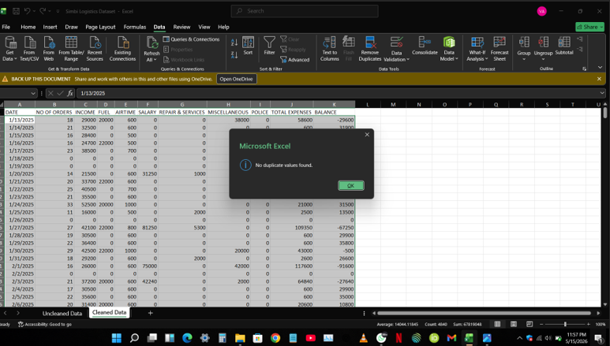
Data Cleaning Process CONT’D
Duplicate Check and Removal: I checked the dataset for duplicate records using the Remove Duplicates feature in the Data tab. No duplicate records were found nor removed from the dataset.

Slide 14
Data Transformation, Analysis and Insights
Tool Used: Power BI
Transformation
I imported the cleaned dataset into my Power BI environment for analysis. As part of the data preparation processes, I transformed the dataset by creating the following columns and measures using the DAX functions.
Column | DAX Function | Measure | DAX Function
Day Name | FORMAT | Average Order | AVERAGE
DayMonthYear | FORMAT | Income Per Order | DIVIDE
MonthYear | FORMAT | Profit Margin | DIVIDE
Week Year | WEEKNUM and YEAR | Total Income | SUM
 |  | Total Orders | SUM
 |  | Total Profit | SUM

Slide 15
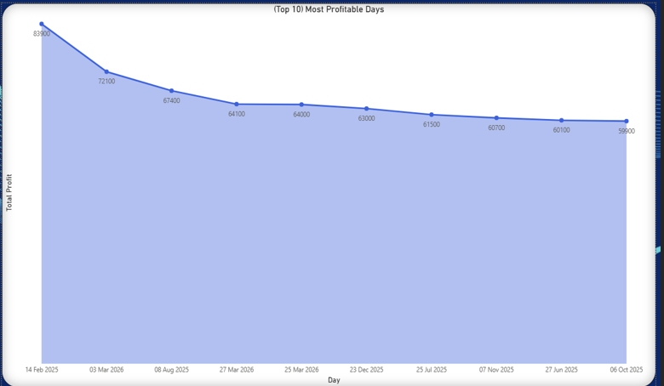
Data Transformation, Analysis and Insights CONT’D
Analysis
1st Objective: Monitor profitability and provide clear visibility into daily, weekly, and monthly financial performance;
1. (Top 10) Most Profitable Days

Slide 16
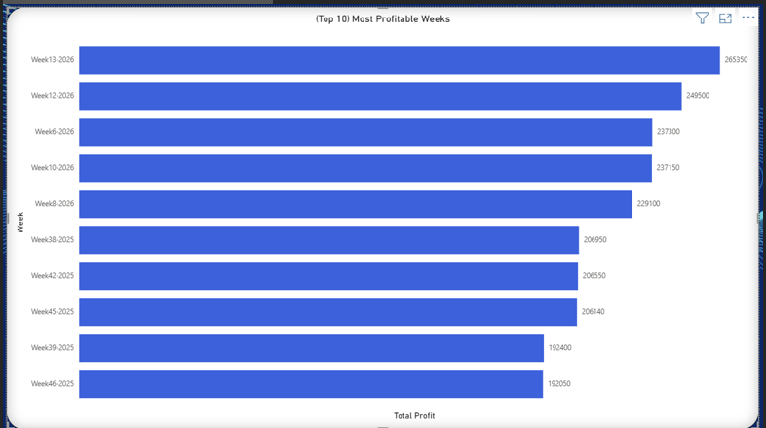
Data Transformation, Analysis and Insights CONT’D
2. (Top 10) Most Profitable Weeks

Slide 17
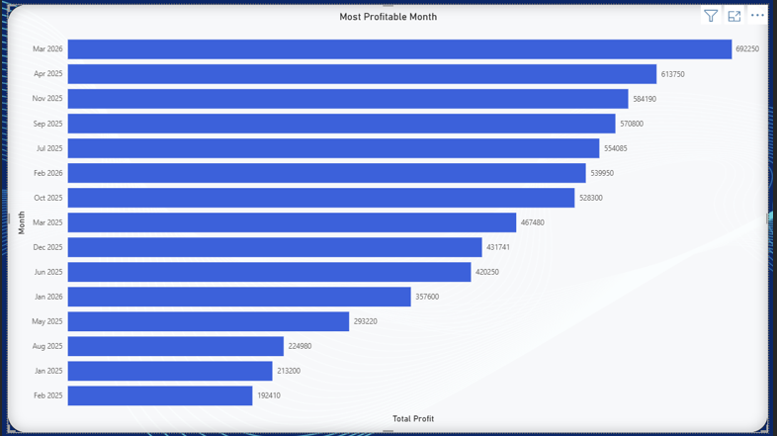
Data Transformation, Analysis and Insights CONT’D
3. Most Profitable Month

Slide 18
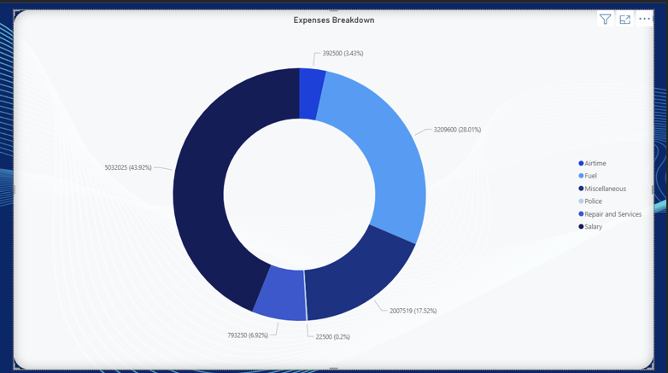
Data Transformation, Analysis and Insights CONT’D
4. Expenses Breakdown

Slide 19
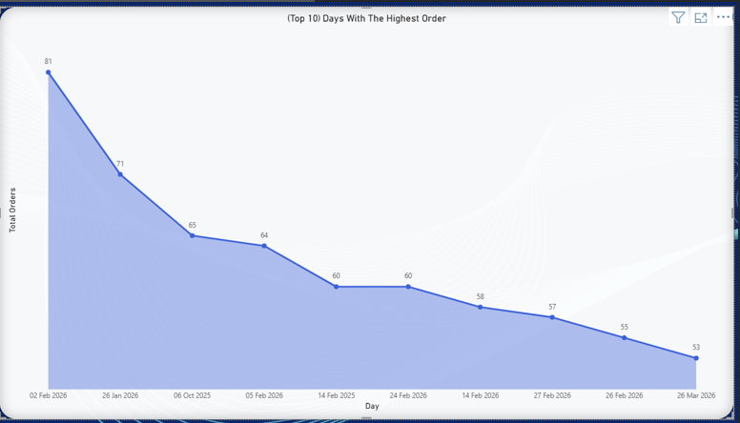
Data Transformation, Analysis and Insights CONT’D
Analysis
2nd Objective: Analyze order trends and patterns to understand business demand, operational performance, and revenue generation across different time periods;
(Top 10) Days With The Highest Order

Slide 20
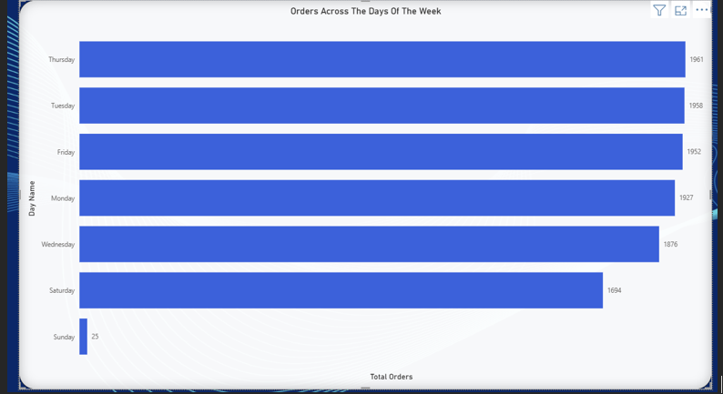
Data Transformation, Analysis and Insights CONT’D
2. Orders Across The Days Of The Week

Slide 21
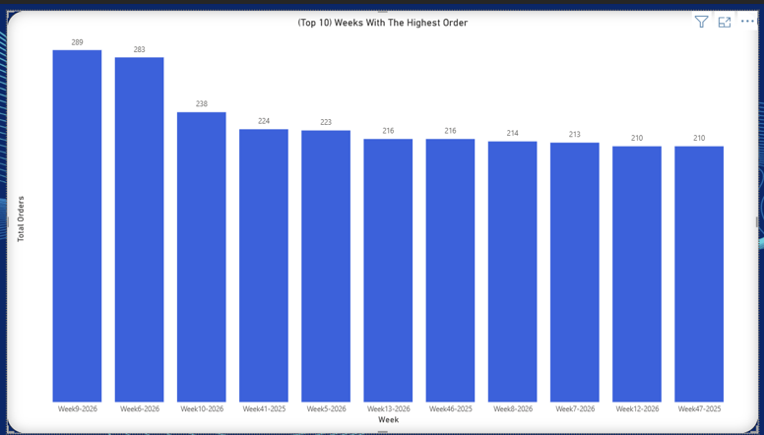
Data Transformation, Analysis and Insights CONT’D
3. (Top 10) Weeks With The Highest Order

Slide 22
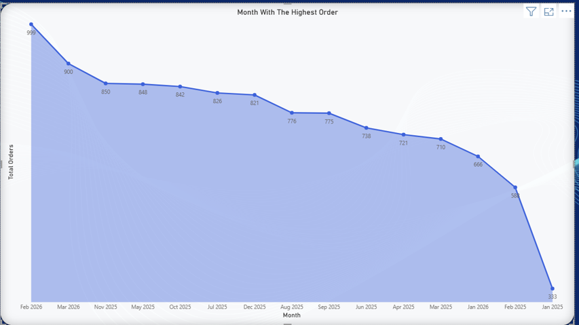
Data Transformation, Analysis and Insights CONT’D
4. Month With The Highest Order

Slide 23
Data Transformation, Analysis and Insights CONT’D
Insight
1st Objective: Monitor profitability and provide clear visibility into daily, weekly, and monthly financial performance;
The first chart shows the top 10 most profitable days, where 14th February 2025 recorded the highest profit of Eighty-Three Thousand, Nine Hundred Naira only (₦83,900), while 6th October 2025 recorded the lowest profit of Fifty-Nine Thousand, Nine Hundred Naira only (₦59,900).
The second chart indicates the top 10 most profitable weeks, where Week 13, 2026 recorded the highest profit of Two Hundred and Sixty-Five Thousand, Three Hundred and Fifty Naira only (₦265,350), while Week 46, 2025 recorded the lowest profit of One Hundred and Ninety-Two Thousand, Fifty Naira only (₦192,050).
The third chart shows the most profitable month, where March 2026 recorded the highest profit of Six Hundred and Ninety-Two Thousand, Two Hundred and Fifty Naira only (₦692,250), while February 2025 recorded the lowest profit of One Hundred and Ninety-Two Thousand, Four Hundred and Ten Naira only (₦192,410).
The fourth chart indicates the expenses breakdown of Simbi Logistics Company from 13th January 2025 to 31st March 2026, where:

Slide 24
Data Transformation, Analysis and Insights CONT’D
Expenses | Amount (₦) | Percentage (%)
Salary | 5,032,025 | 43.92
Fuel | 3,209,600 | 28.01
Miscellaneous | 2,007,519 | 17.52
Repair and Services | 793,250 | 6.92
Airtime | 392,500 | 3.43
Police | 22,500 | 0.2

Slide 25
Data Transformation, Analysis and Insights CONT’D
2nd Objective: Analyze order trends and patterns to understand business demand, operational performance, and revenue generation across different time periods.
The first chart indicates the (top 10) days with the highest order, where 2nd February 2026 recorded the highest number of orders at 81, while 26th March 2026 recorded the lowest number of orders at 53.
The second chart shows the distribution of orders across the days of the week from 13th January 2025 to 31st March 2026, where Thursdays recorded the highest number of orders at One Thousand, Nine Hundred and Sixty-One (1,961), while Sundays recorded the lowest number of orders at Twenty-Five (25).
The third chart indicates the top 10 weeks with the highest order, where Week 9, 2026 recorded the highest number of orders at Two Hundred and Eighty-Nine (289), while Week 47, 2025 recorded the lowest number of orders at Two Hundred and Ten (210).
The fourth chart shows the month with the highest order, where February 2026 recorded the highest number of orders at Nine Hundred and Ninety-Nine (999), while January 2025 recorded the lowest number of orders at Three Hundred and Thirty-Three (333).

Slide 26
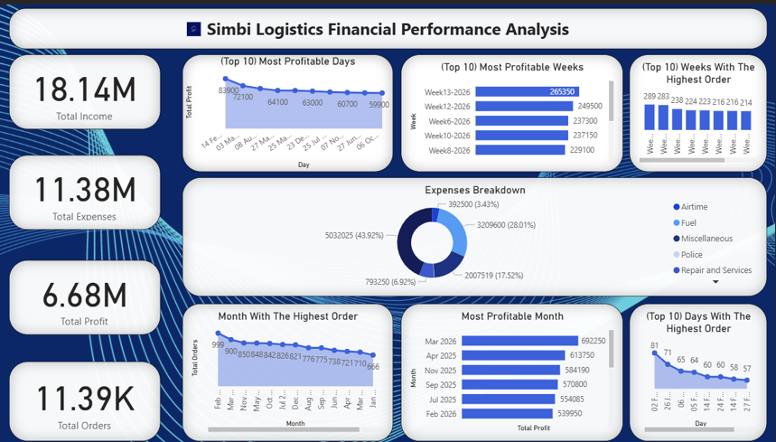
Visualization
The Overview

Slide 27
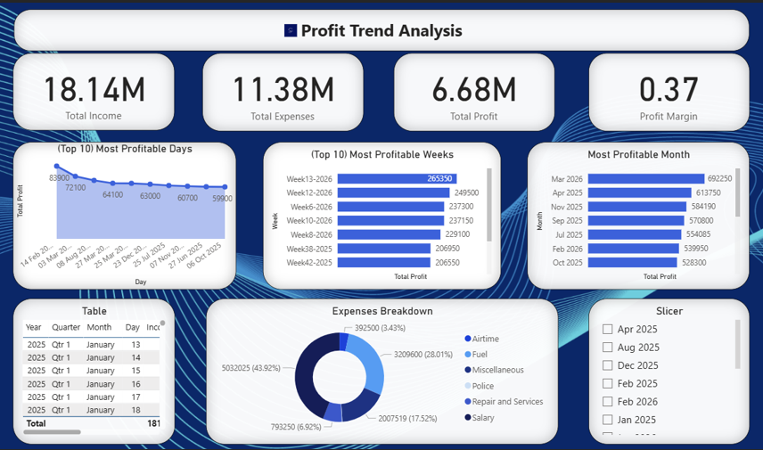
Visualization
Profit Trend Analysis

Slide 28
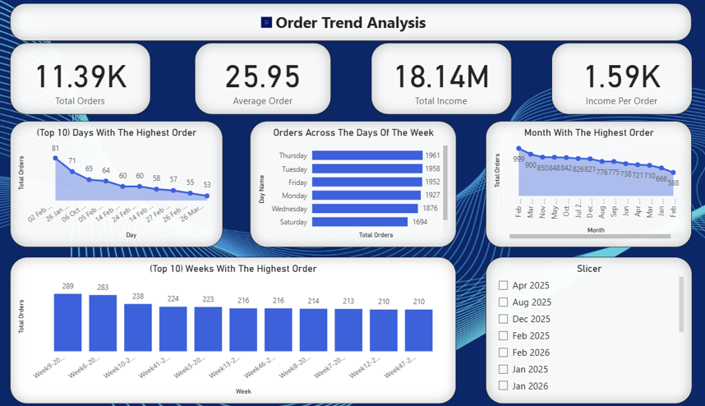
Visualization
Order Trend Analysis

Slide 29
Conclusion
The analysis of Simbi Logistics' data from January 2025 to March 2026 shows that the company has an inconsistent business performance throughout the period, whereby the company achieved its highest profits in March 2026 and April 2025.
The analysis also revealed that Salary and Fuel are the company's largest expenses, accounting for most of the operating costs.
Additionally, the customer demands were higher in February and March 2026.
Thursdays were the busiest days for deliveries, while Sundays recorded the fewest orders.
Overall, the results show that Simbi Logistics is operating profitably and has the opportunities to further improve efficiency, reduce cost and increase revenue.

Slide 30
Recommendations
Monitoring Performance Regularly
The company should continue the use of Power BI dashboards to track profitability, expenses, and order trends for better decision-making.
Controlling Major Expenses e.g. Fueling
The company should pack orders going in the same direction together, to improve delivery efficiency and reduce transportation cost.
Taking Advantage of the Peak Days and Special Days
The company should run promotions and ensure adequate rider availability on Thursdays, which have the highest customer demand. Also, ensure the availability of the riders on the special days like Valentine, Christmas etc…
Boosting Orders During Slow Periods
The company should introduce discounts, loyalty rewards, or special offers on slower days, especially Sundays.
Growing the Customer Base
The company should partner with more businesses, restaurants, supermarkets, and online vendors to increase order volume.
By implementing these recommendations, it will help Simbi Logistics improve profitability, increase operational efficiency, and support long-term business growth.

Slide 31
THANKS!!!

Slide 32
Contact details;
Email: victoradejare04@gmaiil.com
Phone: 09035145179
ORCID: https://orcid.org/0009-0003-5540-6630
GitHub: victoradebiyi01

